Slide 1
Welcome to San Diego
SSG Conference
for Independent Registered Investment Advisors
April 19 – 21, 2018
Paradise Point Resort & Spa
SHAREHOLDERS SERVICE GROUP | Conference 2018

Slide 2
WELCOME!
SHAREHOLDERS SERVICE GROUP | Conference 2018

Slide 3
SSG Conference Tech News
New Offers From:
Riskalyze
RightCapital
Finametrica
Morningstar
SHAREHOLDERS SERVICE GROUP | Conference 2018

Slide 4
SSG Conference Tech Opportunities
Demo Sessions
During Receptions Throughout Conference
Technology Talks
Friday Afternoon at 4:15 pm
Quick Overview of Each Tech Solution
SHAREHOLDERS SERVICE GROUP | Conference 2018

Slide 5
Netx360 Workshop
April 19, 2018
SHAREHOLDERS SERVICE GROUP | Conference 2018

Slide 6
Topics
Alerts
Customization & Cashiering
Report Center
Trading
SHAREHOLDERS SERVICE GROUP | Conference 2018

Slide 7
ALERTS
NETX360 can send Text or E-mail notifications when account or market activity occurs
Alerts are set up using a 4 step Alert Wizard
Types of Alerts and Notification Methods are highly customizable
Advisors can set up alerts for themselves only or include team members
SHAREHOLDERS SERVICE GROUP | Conference 2018

Slide 8
ALERTS WIZARD
SHAREHOLDERS SERVICE GROUP | Conference 2018
Notes:
There may be times when you would like to be notified about activity in client accounts, whether you are logged into NetX360 or away from your office. The NETX360 Alert functions can help. The NETX360 Alert center can be reached by clicking on the applications menu.”

Slide 9
CUSTOM ALERTS
Alert Types
Alert Criteria
Specific Items For Alert
Notification Methods
4 Steps
SHAREHOLDERS SERVICE GROUP | Conference 2018
Notes:
A four step wizard walks you through the process, allowing you to decide which type of alerts you need, and what notification methods you’d prefer. For example, be alerted by text when an incoming check or wire is received into an account. Or, perhaps an e-mail message when an account transfer is completed.”

Slide 10
SPECIFIC ITEMS FOR ALERTS
SHAREHOLDERS SERVICE GROUP | Conference 2018
Notes:
Custom alerts can let you know when cash hits an account, leaves an account, runs too low or is disproportionately high. In this example, the advisor wants to be alerted when a cash balance hits a specific threshold, a debit balance occurs, cash is received into the account, or a 529 plan has uninvested cash available for investment.”

Slide 11
NOTIFICATION METHODS
SHAREHOLDERS SERVICE GROUP | Conference 2018
Notes:
The four step process ends by selecting your notification methods. Advisors can chose to have an e-mail alert mailed to themselves, and team members of their firm. Advisors may also choose to receive a text alert for real time notifications when out of the office

Slide 12
CUSTOMIZATION/CASHIERING
Home Tab
Individual Account
Balances, Holdings, Documents, Profile, Activity, Work Items All, Order Trade Status, IFA’s
Service and Operations – Asset Movement
Check Requests
ACH Withdrawals
SHAREHOLDERS SERVICE GROUP | Conference 2018

Slide 13
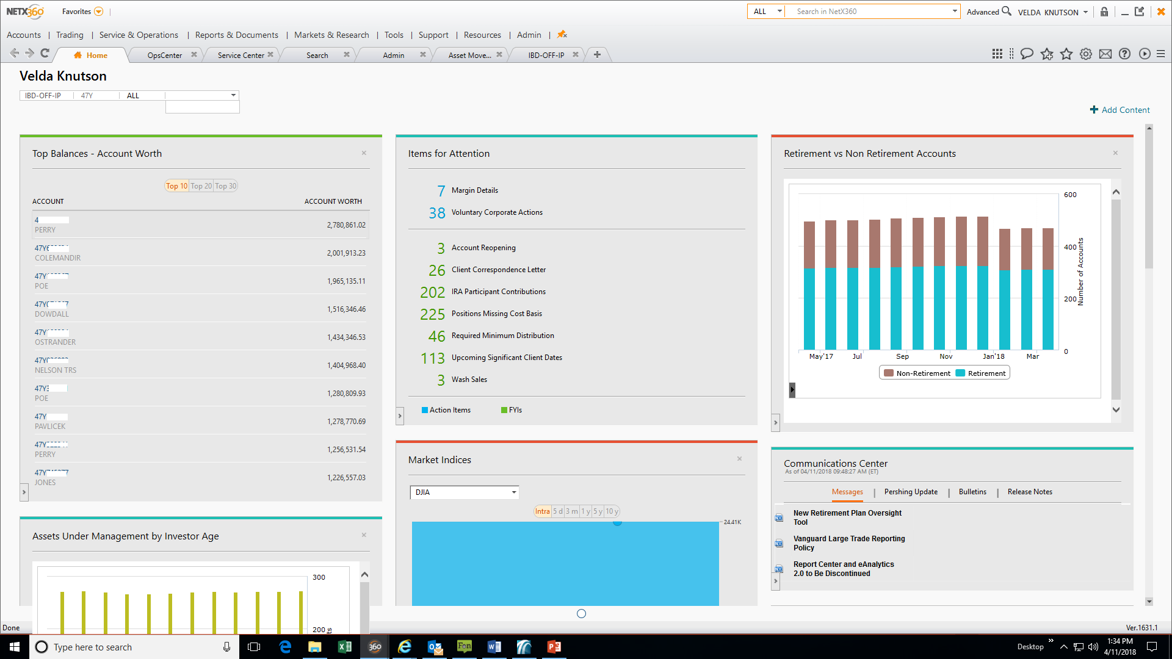
HOME PAGE - CUSTOMIZED
Dashboard
Add/Remove Content
Top Balances
Items for Attention
Hyper Links
SHAREHOLDERS SERVICE GROUP | Conference 2018
Notes:
Velda

Slide 14
HOUSEHOLDS

Slide 15
HOLDINGS – GAINS/LOSS

Slide 16
SPLIT SCREEN & ADD SCREEN

Slide 17
ASSET MOVEMENT – CHECK REQUEST

Slide 18
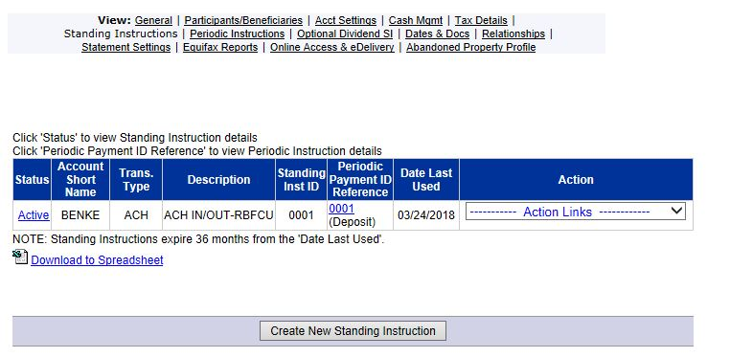
ACH WITHDRAWAL
SHAREHOLDERS SERVICE GROUP | Conference 2018
Notes:
Velda

Slide 19
REPORT CENTER
Report Center - New
Use a Template or Build Your Own
Save & Schedule Reports
Easily Exports to Excel
SHAREHOLDERS SERVICE GROUP | Conference 2018

Slide 20
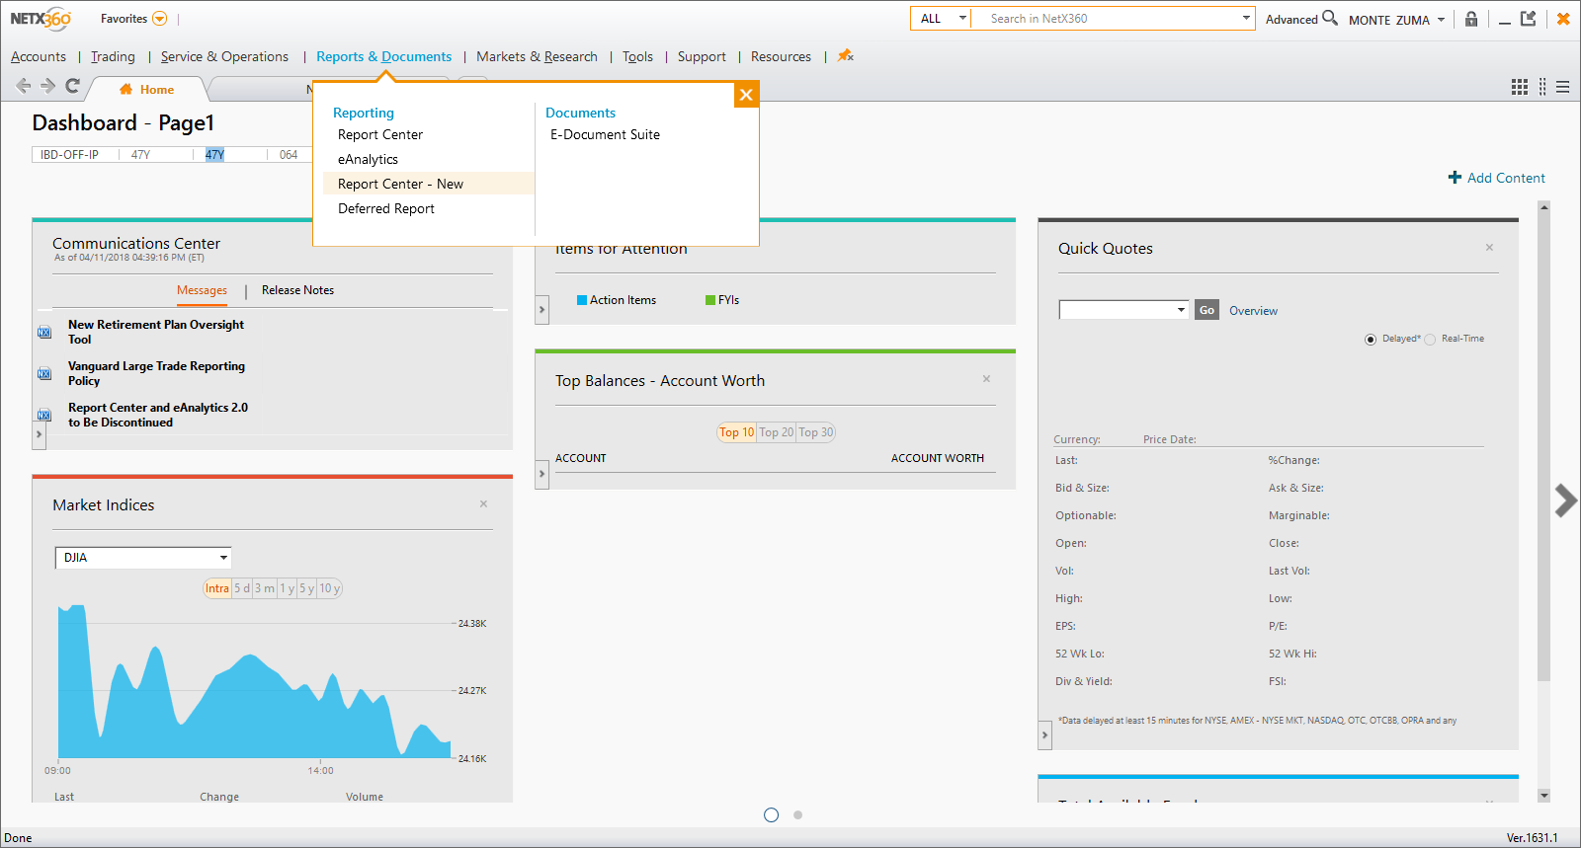
REPORT CENTER – NEW!
SHAREHOLDERS SERVICE GROUP | Conference 2018

Slide 21
TEMPLATE OR BUILD YOUR OWN
SHAREHOLDERS SERVICE GROUP | Conference 2018

Slide 22
BALANCES REPORT
SHAREHOLDERS SERVICE GROUP | Conference 2018

Slide 23
SAVE & SCHEDULE REPORTS
SHAREHOLDERS SERVICE GROUP | Conference 2018

Slide 24
EXPORT TO EXCEL
SHAREHOLDERS SERVICE GROUP | Conference 2018

Slide 25
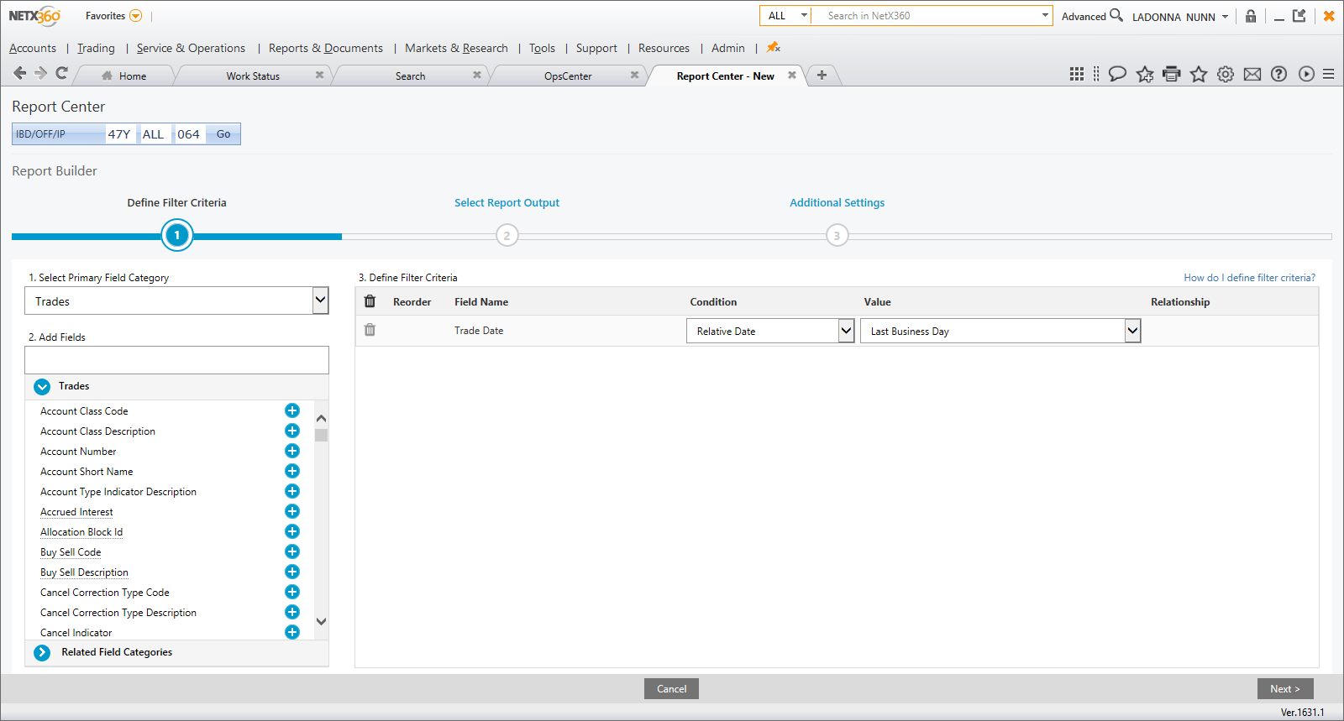
REPORT BUILDER – ENDLESS POSSIBILITIES
SHAREHOLDERS SERVICE GROUP | Conference 2018

Slide 26
SSG TRADING
Mutual Fund
Equity/ETF
Options
Fixed Income
SHAREHOLDERS SERVICE GROUP | Conference 2018

Slide 27
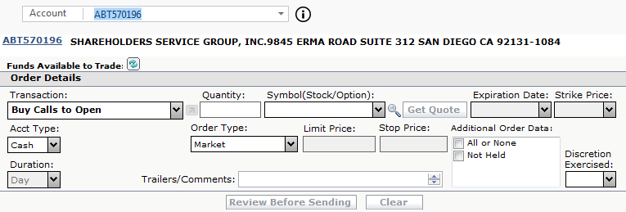
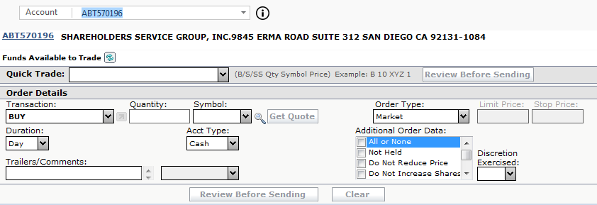
MUTUAL FUND
EQUITY/ETF
OPTIONS
SHAREHOLDERS SERVICE GROUP | Conference 2018

Slide 28
SHORTCUT TO TRADING SCREEN
SHAREHOLDERS SERVICE GROUP | Conference 2018

Slide 29
FIXED INCOME
Research & Building Portfolio
Trades must be called into Trade Desk
SHAREHOLDERS SERVICE GROUP | Conference 2018

Slide 30
ADDITIONAL FEATURES
Mutual Fund Order Import
Equity/ETF Order Import
Equity Block Trading
Block Trading & Rebalancing
Dividend Reinvestment (Equities & Mutual Funds)
Selling Tax Lots
SHAREHOLDERS SERVICE GROUP | Conference 2018

Slide 31
IMPORTS
Menu / Trading / Order Trade Entry / Equity ETFs Order Import
Menu / Trading / Order Trade Entry / Mutual Fund Order Import
SHAREHOLDERS SERVICE GROUP | Conference 2018

Slide 32
INTERACTIVE PODS
Alerts (Alan)
Customization & Cashiering (Velda)
Report Center (Ladonna)
Trading (Tim)
Come Up to Learn More!
SHAREHOLDERS SERVICE GROUP | Conference 2018

