Slide 1
NEW TAX LAWS
Traps & Opportunities

Slide 2
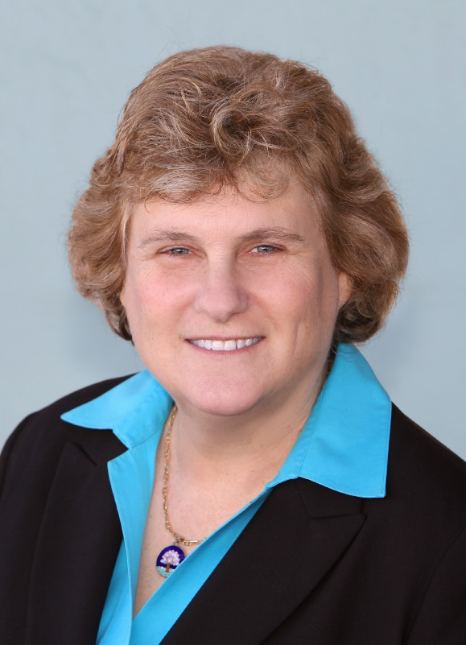
Speaker Biography
Sheryl Rowling, CPA/PFS
Principal, Rowling & Associates
Head of Rebalancing Solutions, Morningstar
Author of: “Tax & Wealth Strategies for Family Businesses” (CCH), “Your Financial Travel Guide to Life” (Lulu)
Columnist for InvestmentNews, Advisors4Advisors and San Diego Jewish World
Providing tax & financial advice since 1979
Member of AICPA, Cal Society of CPAs, All-Star Financial Group
Recognized as Top Financial Advisor (Worth), 5-Star Wealth Advisor (San Diego magazine), One of 100 Most Influential (Accounting Today)

Slide 3
AGENDA
Overview
Advisor Strategies
Client Strategies
Individuals
Businesses

Slide 4
Tax Cut & Jobs Act (TCJA) Overview
Complex
Slashes Corporate Tax Rates
Mixed Bag for Individuals
Cost = $1.5 trillion

Slide 5
Individual vs. Business Provisions
Individual provisions
Business provisions
Cuts tax rates
Eliminates Personal Exemptions
Increases Standard Deduction
Cuts or eliminates many itemized deductions
Primarily for high income taxpayers
Impacts families and elderly
Offset by elimination of personal exemptions
Hurts taxpayers in unexpected ways
Not permanent!
Most provisions expire after 2025
Cuts tax rates
Top corporate rate 21%
Eliminates Corporate AMT
Amplifies corporate rate reduction
Cuts or eliminates many deductions
Disproportionate impact to smaller businesses
Pass-through entities deduction
Very limited 20% deduction for non-corporate businesses

Slide 6
Details: Individual tax reductions
Max tax rate 37%
Prior max 39.6%
Doubles Standard Deduction
$12k singles and $24k marrieds
Material reductions not until taxable income > $75k singles and $150k marrieds
Fewer people will itemize
AMT exemptions increased
Fewer people will be subject to AMT
If subject to AMT, will pay less
Increases child credits
$2,000 per child, up to $1,400 refundable
$500 credit for non-child dependents
Must have Social Security numbers
Doubles estate tax exemption
$11.2 million per individual, $22.4 million per married couple
Benefits only ultra-wealthy
529 Plan use expanded
Can now be used to fund private school (primary & secondary education)

Slide 7
Details: Individual tax Increases
Eliminates personal exemptions
At current $4,050 each, offsets much of standard deduction increase
Reduces mortgage interest deductions
Max principal $750,000
No deduction for home equity interest
Eliminates miscellaneous itemized deductions
Tax prep fees
Investment management fees
Employee business expenses
Professional & union dues
Reduces state & local tax deductions
Maximum deduction for combined state, local & property taxes = $10,000
Fewer people will itemize
Hurts high tax states
Could depress housing markets
Eliminates moving expense deductions
Except for military
Places financial burden on workers who need to move for job
Eliminates casualty loss deductions
Except for presidentially declared disasters

Slide 8
Details: Business tax reductions
Max corporate tax rate 21%
Prior max 35% - 38%
Pass-through entity tax deduction
AMT eliminated
Applies to all non-corporate entities
Does not apply to personal service businesses unless taxable income less than:
$157,500 for singles
$315,000 for marrieds
If qualified, deduction is lesser of 20% of QBI or taxable income
Other business get a deduction of the lesser of:
20% of QBI or
Greater of
50% of W-2 wages or
25% of W-2 wages plus 2.5% of unadjusted property placed in service since 2008
Work with CPA

Slide 9
Details: Business tax Increases
Eliminates entertainment expenses
Includes meals & entertainment
Does not impact travel meals
Capitalizes research & development costs
Must be amortized over 5 years
Specifically includes software development
Excludes oil & gas

Slide 10
CLIENT STRATEGIES
Strategies must be individualized
Depends on client situation
Could differ year-by-year

Slide 11
Client Strategy #1: Itemize or Standard Deduction?
Medical Expenses > 7.5% AGI
Mortgage Interest within Limits
Charitable Contributions
State, Local & Property Taxes up to $10,000
$12,000 Single or $24,000 Married

Slide 12
Client Strategy #1: Itemize or Standard Deduction Example
 | Taxes | Interest | Charity | Misc.
2017 | Prop. Tax $12,000 State Tax $9,000 | Mortgage Interest $8,000 Home Eq. Interest $4,000 | Charitable Cont. $3,000 | Tax Prep. $1,000 Inv. Mgt. $10,000 – 2% AGI
2018 | Total Taxes $10,000 | Mortgage Interest $8,000 | Charitable Cont. $3,000 | N/A

Slide 13
Client Strategy #1: Itemize or Standard Deduction Importance
If Itemizing
Maximize unlimited deductions
Plan for limited deductions
If Standard Deduction
Remember no benefit for “deductible” expenses
Focus on “above-the-line” deductions

Slide 14
Client Strategy #2: Bunch Itemized Deductions
Itemize One Year
Standard Deduction the Next Year

Slide 15
Client Strategy #2: Bunch Itemized Deductions
 | State Taxes | Prop Taxes | Interest | Charity
2018 | $6,000 | $2,000 | $12,000 | $2,000
2018 (w/planning) | $7,000 | $3,000 | $13,000 | $4,000
2019 (w/planning) | $6,000 | $1,000 | $11,000 | $0
Result
No Planning: $24,000 standard deduction each year
2018 (w/planning): $27,000 itemized deductions
2019 (w/planning): $24,000 standard deduction

Slide 16
Client Strategy #3: Donor Advised Fund (DAF)
Basic
Write checks to charity
Advanced
Give appreciated shares
Super-Charged
Give appreciated stock to Donor Advised Fund

Slide 17
Client Strategy #3: Donor Advised Fund (DAF)
DAF
Open DAF at Community Foundation or Custodian
Contribute Appreciated Shares
Immediate deduction at FMV
Grant to Charities
Give when & amount you want
LT appreciation not taxed
Easy record-keeping
Earns return while in DAF

Slide 18
CLIENT STRATEGY #4: Qualified Charitable Distribution (QCD)
How It Works
When it’s Beneficial
Send RMD directly to charity
Not to DAF
RMD not taxable
Reduces AGI
Donation not deductible
70-1/2 or older
Charitable intent
Standard deduction
AGI impacts

Slide 19
Advisor STRATEGIES
What is your value add?
Fees are not deductible
Commissions are deductible!

Slide 20
Advisor Strategy #1: Take Focus away from Performance
Investing is becoming commoditized
Pricing is becoming more competitive
Need to focus on what advisor adds other than performance

Slide 21
Advisor Strategy #1: Take Focus away from Performance
Walk the walk!
Educate your clients
Change Quarterly Report format
Financial Planning
Be proactive!
Webinars & Seminars
Emails
Blogs & Newsletters
Quarterly Reports
Meetings
More on progress toward goals
Less on performance vs. benchmark
More on performance vs. individualized target

Slide 22
Advisor Strategy #2: Tax Management
Tax Loss Harvesting
Tax Gain Harvesting
Charitable Giving
Capital Gain Distribution Avoidance
Roth Conversion

Slide 23
Advisor Strategy #3: Get Help!
Technology
Allows for scalability
Reduces errors
Outsource
Access to expertise
Safeguards continuity
Easier compliance
Lets you focus on clients

Slide 24
Advisor Strategy #3: Get Help!
CRM
Portfolio Accounting & Rebalancing
Financial Planning
CRM
Junxure
PAS
Rebalancing
Redtail
PortfolioCenter
Power Advisor
Morningstar Office
Total Rebalance Expert (Morningstar)
Financial Planning
Money Guide Pro
E Money
Technology

Slide 25
Advisor Strategy #3: Get Help!
Downloads, Billing & Portfolio Accounting
Investment Strategy
Portfolio Management & Rebalancing
Portfolio Management & Rebalancing
InStrategy (Rowling & Associates)
Investment Strategy
Morningstar Managed Portfolios
InStrategy
Morningstar
Various TAMPS
Downloads, Billing & Portfolio Accounting
BOSS
ABC
Outsource

Slide 26
Strategies Summary
Clients
Advisors
Itemize or Standard Deduction
Bunch deductions
Donor Advised Fund
Qualified Charitable Distribution
Don’t focus on performance
Tax management
Get help!

Slide 27
THANK YOU!
Time for Questions….
Please contact us if you have follow-up questions or comments!
info@rowling.com
sheryl@rowling.com

