Slide 1
The Value of Being Different Kim Vinick & Chris Niemczewski Marshfield Associates

Slide 2
Lessons Learned From the Field
Successful Advisors Are Different in Ways That
Help Them Thrive
Differentiate
What makes you unique?
What are your advantages and opportunities that you should capitalize on?
How can you build a moat around your business?
Notes:
Kim,
The Capital Preservation here is different than the RBC October 2016 doc. Let me know if I need to adjust.

Slide 3
Building Your Business
Business Development . . .
Go an Inch Wide and a Mile Deep
DON’T Try to be All Things to All People.
Notes:
Kim,
The Capital Preservation here is different than the RBC October 2016 doc. Let me know if I need to adjust.

Slide 4
Building Your Business
Seize Opportunity When You See It . . .
Recognize Special Opportunities / Obvious Referrals:
Professionals (doctors, race car drivers, small business ESOPs)
Fellow-Club/Church/Activities Participants
LGBTQ
Life Transitions (widowhood/divorce/marriage/children/elderly parents)

Slide 5
Building Your Business
. . . Create It When You Don’t
Build Relationships & Trust, Not Just AUM
Focus on the Client’s Goals – Generational Wealth Planning; Create Opportunities to Meet Children/Extended Family
Become An Expert
Subject Matter - Social Security; Retirement Planning; TIAA/CREF
Public Communications - Build great public speaking skills; volunteer to speak at events and meetings; appear on radio/TV; conduct seminars
Collaborate With People Who Share Your values
The company you keep – Clients; External Partners; Team Members; Referral Sources

Slide 6
Building Your Business
You are Your Team’s MVP
Act Like It!
Team
Support Staff
Partners
Coach
Implementation
Ringers
Community Referral Network
Discipline
Outside Managers
Most
Valuable
Pursuit
Notes:
Kim,
The Capital Preservation here is different than the RBC October 2016 doc. Let me know if I need to adjust.

Slide 7
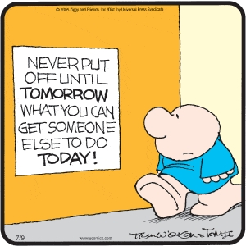
Manage Your Business
Delegate . . . And Guard Your Time
http://www.absencehub.com/the-art-of-delegation-increasing-productivity-creating-results-nurturing-a-healthy-work-environment/
Notes:
Kim,
The Capital Preservation here is different than the RBC October 2016 doc. Let me know if I need to adjust.

Slide 8
Manage Your Book
Manage Your Book . . . Don’t Let It Manage You
Rank Your Accounts
By AUM? By Value to You?
Top 20% -- Lots of Love
Focus efforts here. Communicate regularly. Focus on client, not just the account.
Middle 60% -- Move Them Up
Implement communications plan to move clients to top tier. If you can’t, make sure you know why you are spending time with them.
Bottom 20% -- Move them Out?
Often time killers. Delegate to a team member or someone in your office? Fire them?

Slide 9
The Investment Value of Being Different

Slide 10
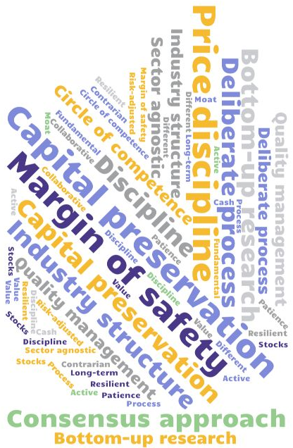
Philosophy
We Seek to Be Different in Ways that Improve Performance
Concentrated Portfolio
Sector Agnostic
Strict Price Discipline
Willing to Hold Cash
Low Turnover
Notes:
Kim,
The Capital Preservation here is different than the RBC October 2016 doc. Let me know if I need to adjust.

Slide 11
Research Process
Research
In-house & bottom-up
Four voting members who are principals of the firm. Six members total.
Consensus-based decision making and no “silos”
Continuously review companies in portfolio and of interest

Slide 12
Philosophy
Investment Criteria:
High-Quality Companies with Very Specific Characteristics
Industry structure conducive to high returns on capital
Exceedingly strong financial profile
Moat around the business
Management excellence
Culture that is appropriate to the business
Notes:
Sub photo from istock--https://www.istockphoto.com/photo/metal-wheel-concept-gm862704568-143029863

Slide 13
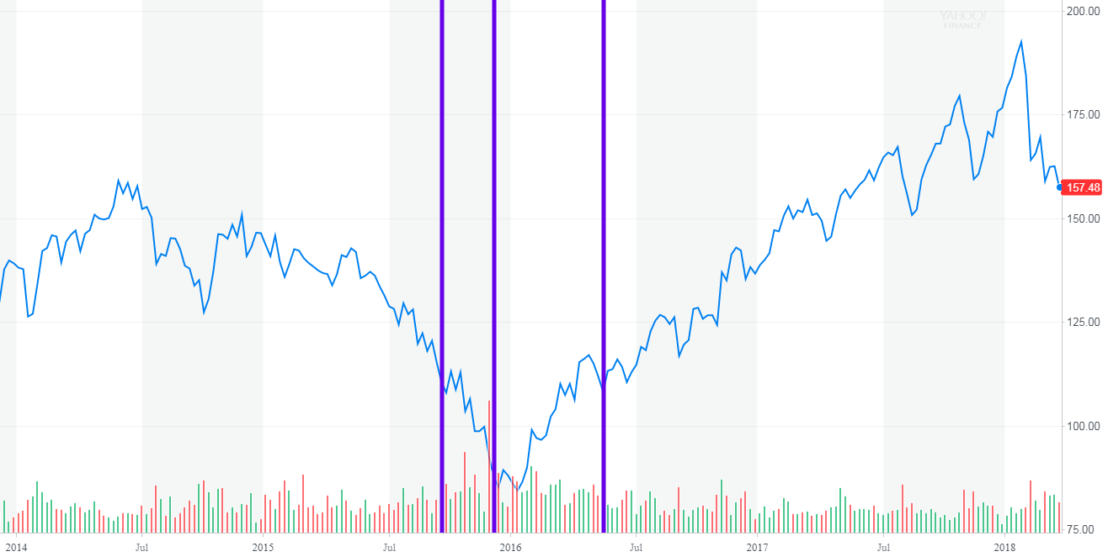
Cummins (CMI)
Initial purchase: Sept. 21-18, 2015
Subsequent purchases: Dec. 2-3, 2015; May 19, 2016
Cummins Inc. Stock Price, January 1, 2014 – March 22, 2018, via Yahoo! Finance, accessed March 23, 2018.
The information contained in this document is confidential and intended only for the use of the financial advisor to which it is provided. It is not for distribution to newswire services or for release, publication, distribution or dissemination directly, or indirectly, in whole or in part, to others beyond the intended recipient of this document. It should not be assumed that any securities transactions, holdings or sectors discussed were or will be profitable, or that the investment recommendations or decisions that Marshfield makes in the future will be profitable or will equal past investment performances. It should not be assumed that every client purchased shares at all of the entry points. The opinions and strategies of Marshfield are subject to change at any time.

Slide 14
AutoZone (AZO) and O’Reilly Automotive (ORLY)
AZO
Initial purchases May 23-31, 2017
Additional purchases July 5-11, 2017
ORLY
Initial Purchase July 6-7, 2017
Stock price graph for Autozone and O’Reilly Automotive January 1, 2014 – March 22, 2018, via Bloomberg LP, accessed March 23, 2018.
The information contained in this document is confidential and intended only for the use of the financial advisor to which it is provided. It is not for distribution to newswire services or for release, publication, distribution or dissemination directly, or indirectly, in whole or in part, to others beyond the intended recipient of this document. It should not be assumed that any securities transactions, holdings or sectors discussed were or will be profitable, or that the investment recommendations or decisions that Marshfield makes in the future will be profitable or will equal past investment performances. It should not be assumed that every client purchased shares at all of the entry points. The opinions and strategies of Marshfield are subject to change at any time.

Slide 15
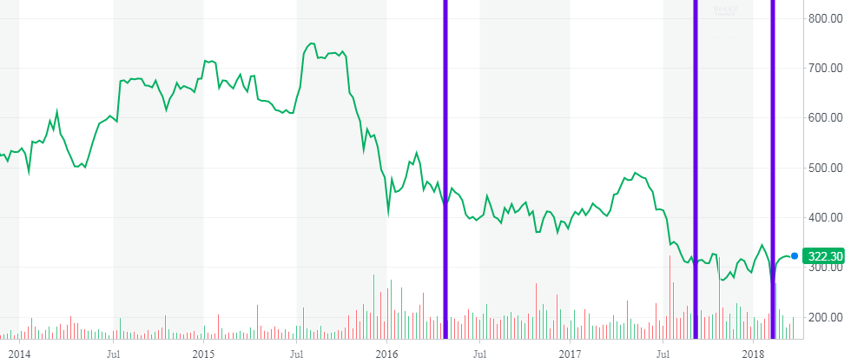
Chipotle (CMG)
Initial purchase April 27, 2016
Additional purchase September 9, 2017 and February 6-7, 2018
Stock price graph for Chipotle Inc. January 1, 2014 – March 22, 2018, via Yahoo! Finance, accessed March 23, 2018.
The information contained in this document is confidential and intended only for the use of the financial advisor to which it is provided. It is not for distribution to newswire services or for release, publication, distribution or dissemination directly, or indirectly, in whole or in part, to others beyond the intended recipient of this document. It should not be assumed that any securities transactions, holdings or sectors discussed were or will be profitable, or that the investment recommendations or decisions that Marshfield makes in the future will be profitable or will equal past investment performances. It should not be assumed that every client purchased shares at all of the entry points. The opinions and strategies of Marshfield are subject to change at any time.

Slide 16
Firm Overview
Marshfield Snapshot
Context
Concentrated, long only value equity manager
Culture
Seven principals own 100% of the firm
Average tenure of principals is 22 years
Commitment
Marshfield principals “eat our own cooking”
Buy for our own accounts only those stocks we buy for our clients
We own no other publicly traded equities
Notes:
Sub with stock download from : https://www.shutterstock.com/image-photo/young-fashion-hipster-smiling-girl-hat-446949811?irgwc=1&utm_medium=Affiliate&utm_campaign=Elevated%20Logic%2C%20LLC&utm_source=426523&utm_term=STOCKSNAP_SEARCH-NORMAL_API

Slide 17
21 Dupont Circle
Suite 500
Washington, DC 20036
202.828.6200 office
202.828.6208 fax
marketing@marshfieldinc.com
www.marshfieldinc.com

